Slide 1

D E B H A A
Dynamic Eco-Friendly Bin for Hi-Tech Automatic Assortment

Slide 2
Parth Kambli - 2103079
Dhruv Kheni - 2103090
Ishaan Mavinkurve - 2103116
Daryn Monteiro - 2103119
Supervisor: Prof. Sakshi Surve

Slide 3
PROBLEM STATEMENT
Current waste management systems struggle with inefficient and error-prone manual sorting processes.
This results in increased environmental pollution and resource wastage.
There is a need for a smart dustbin that can automatically segregate waste based on its type to enhance recycling efficiency and reduce environmental impact.

Slide 4
MOTIVATION
There has always been a concern about the growing environmental impact of improper waste management
Observing the inefficiencies and manual errors in current systems has motivated us to develop a smart dustbin.
By leveraging IoT, we aim to create a solution that automatically sorts waste, enhances recycling efficiency and promotes a cleaner, more sustainable environment.

Slide 5
APPLICATIONS
Residential Households
Waste Management Authorities
Commercial Establishments
Educational Institutions
Public Spaces
Homeowners who want to simplify waste segregation and enhance recycling efforts.
City and local government agencies responsible for waste collection and processing.
Businesses and offices seeking efficient waste management solutions.
Schools and universities aiming to promote recycling and environmental awareness among students.
Parks, malls, and other public areas where efficient waste segregation can improve cleanliness and sustainability.

Slide 6
INPUTS AND OUTPUTS
Outputs:
Sorted waste
Data reports
Inputs:
Waste items
Sensors
User interaction
Power supply

Slide 7
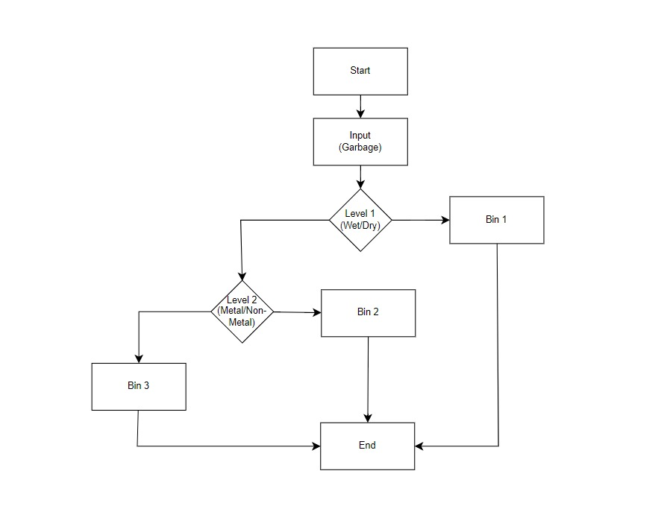
BLOCK DIAGRAM
Dry
Wet
Non-Metal
Metal

Slide 8
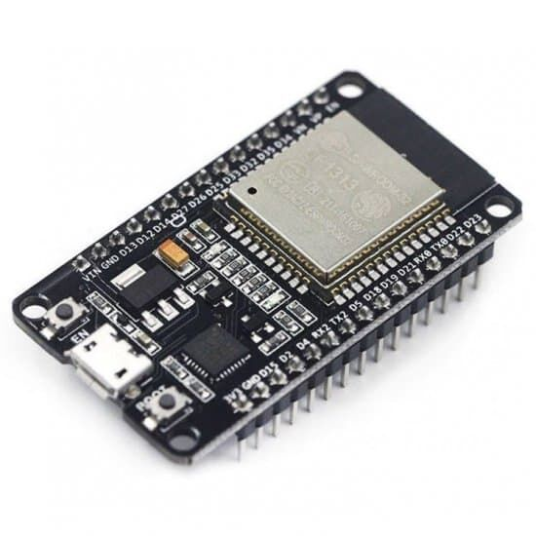
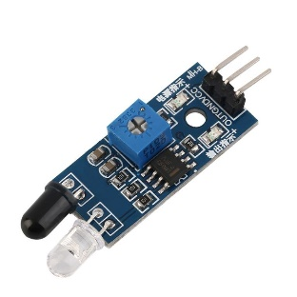
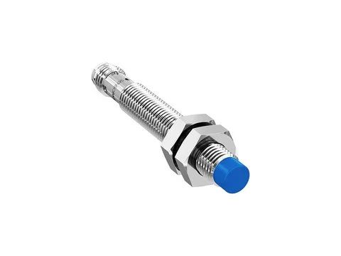
COMPONENTS
ESP32 Microcontroller
Acts as the brain of the system, processing sensor inputs .
Controls the servo motor to direct waste into the correct bin.
Provides wireless connectivity for future scalability.
IR Sensor
Detects the presence of incoming waste.
Sends a signal to trigger waste classification.
Inductive Proximity Sensor
Identifies metallic waste by detecting electromagnetic field disturbances.
Ensures metal objects are separated efficiently.

Slide 9
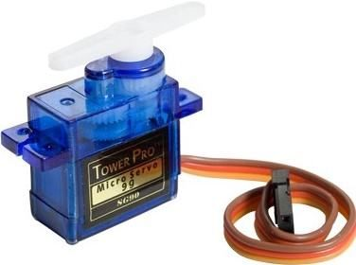
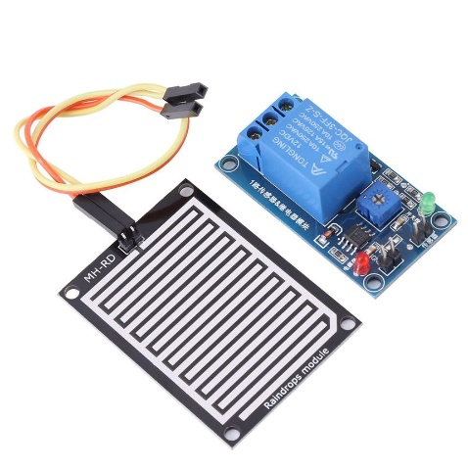
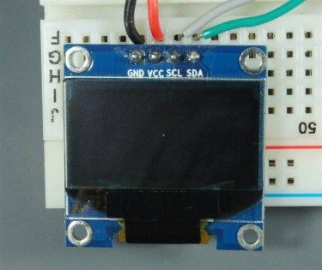
COMPONENTS
Servo Motor
Controls the movement of the waste segregation mechanism.
Rotates to direct waste into the appropriate bin based on sensor input.
Raindrop Sensor
Detects moisture levels in waste.
Helps differentiate between wet and dry waste for proper disposal.
OLED Display
Displays real-time waste classification results (Wet, Dry, or Metallic).
Provides an interface for system status updates.

Slide 10
ESP32 VS ARDUINO
Feature | ESP32 | Arduino (Uno, Nano, etc.)
Processing Power | Faster Processing Power | Comparatively slower processing power
Wireless Connectivity | Built-in Wi-Fi and Bluetooth (BLE + Classic) (enables Blynk connectivity) | No built-in Wi-Fi or Bluetooth (external modules needed)
Memory | ~520 KB SRAM + external flash support | 2 KB SRAM
Number of GPIOs & Features | ~36 GPIOs, capacitive touch, ADC, DAC, SPI, I2C, CAN, Ethernet MAC | ~14 GPIOs, ADC, SPI, I2C
Power Management | Advanced sleep modes for ultra-low power IoT applications | Basic sleep modes, higher overall power consumption

Slide 11
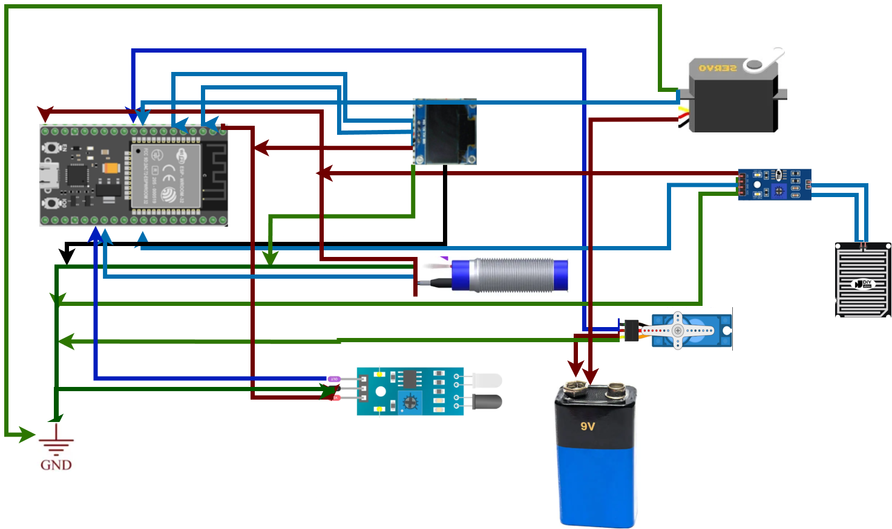
PIN DIAGRAM

Slide 12
ADVANTAGES OF AUTOMATED SORTING
Human Effort: Traditional sorting relies on people to manually separate waste, while an automated bin does the sorting with little to no user input.
Speed and Efficiency: Manual sorting is time-consuming and inconsistent, whereas automated bins can sort waste quickly and more efficiently.
Accuracy: Sorting accuracy depends on how well-informed or careful the person is; smart bins use sensors or programmed logic for more precise classification.
Hygiene and Safety: Traditional sorting exposes people to potentially hazardous waste, but automated bins reduce direct contact, improving hygiene and safety.

Slide 13
POTENTIAL DRAWBACKS
False Positives: Some cases might lead to a false reading due to faulty sensors or potential drawbacks in hardware.
High Initial Cost: Smart bins require investment in sensors, microcontrollers, and mechanical parts, making them more expensive upfront than traditional bins.
Maintenance Requirements: Sensors, motors, and electronics can fail or need regular maintenance, which adds extra effort and cost.
Limited Sorting Capabilities: Automated systems may struggle to correctly identify mixed materials, dirty waste, or unusual items outside of their trained categories.
Power Dependency: These bins rely on electricity or batteries; if power fails, the automated features stop working.
Complexity in Design: Designing a reliable, accurate sorting mechanism can be technically challenging and requires careful calibration.

Slide 14
REFERENCES
[1]Waste Sorting Dustbin with Arduino based Smart Motor Rotating Tray, accessed on
26 July, 2024 (online)
https://www.academia.edu/91551421/Waste_Sorting_Dustbin_with_Arduino_based_Smart_Motor_Rotating_Tray
[2]Edge AI Audio Classifier Recycle Bin: Product Demo accessed on 24, July 2024 (online)
https://www.youtube.com/watch?v=roWY29RNFU0&t=3s

Slide 15
Thank you!

